Slide 1
UNIVERSITÀ DEGLI STUDI DI PERUGIA
International Doctoral Program in
Civil and Environmental Engineering
PYTHON FOR NUMERICAL COMPUTING AND DEVELOPMENT OF SCIENTIFIC APPLICATION
Prof. Federico Cluni
A. Y. 2021/22
Lesson #3 – May 10, 2022

Slide 2
Classes
A class is an entity which has attributes, that can be variables storing data and methods, i.e. functions with operates on the data of the class or on external objects.
class Punto:
"Classe per gestire un punto geometrico."
def __init__(self,x,y,z=0):
self.x=x
self.y=y
self.z=z
def Distanza(self):
"Determina la distanza del punto dall'origine."
return ( self.x**2 + self.y**2 + self.z**2 )**0.5
Once a class has been defined, we can define an instance of that class through the name of the class and, in round bracket, the arguments that are passed to the method which is the constructor for the class, __init__
The string literal is assigned to the method __doc__
Notes:
See https://docs.python.org/3/tutorial/classes.html#a-first-look-at-classes for a detailed description

Slide 3
Classes - Inheritance
New classes can be defined by existing ones.
class Punto:
"Classe per gestire un punto geometrico."
def __init__(self,x,y,z):
self.x=x
self.y=y
self.z=z
def Distanza(self):
"Determina la distanza del punto dall'origine."
return ( self.x**2 + self.y**2 + self.z**2 )**0.5
def Trasla(self,Dx,Dy,Dz):
self.x += Dx
self.y += Dy
self.z += Dz
def Ruota(self,x0,y0,z0,ax,ay,az):
self.x, self.y, self.z = self.x-x0, self.y-y0, self.z-z0
self.x, self.y, self.z = self.x*cos(az)-self.y*sin(az), \
self.x*sin(az)+self.y*cos(az), self.z
self.x, self.y, self.z = self.x, self.y*cos(ax)-self.z*sin(ax), \
self.y*sin(ax)+self.z*cos(ax)
self.x, self.y, self.z = self.x*cos(-ay)-self.z*sin(-ay), self.y, \
self.x*sin(-ay)+self.z*cos(-ay)
self.x, self.y, self.z = self.x+x0, self.y+y0, self.z+z0

Slide 4
Classes - Inheritance
New classes can be defined by existing ones.
class Punto2D(Punto):
"Classe per gestire un punto geometrico nel piano x, y."
def __init__(self,x,y):
Punto.__init__(self,x,y,0)
def Trasla(self,Dx,Dy):
Punto.Trasla(self,Dx,Dy,0)
def Ruota(self,x0,y0,az):
Punto.Ruota(self,x0,y0,0.,0.,0.,az)
def Anomalia(self):
return atan2(self.y, self.x)
Remark
- the method «Distanza» has NOT be redefined!
- if the class belong to a different module,
class NewClass(ModulName.BaseClass):

Slide 5
Classes – Private attributes/method
To define attributes and method as private, i.e. they can not be accessed from outside the class, a special naming convention is used.
.__name_
class Punto2D(Punto):
"Classe per gestire un punto geometrico nel piano x, y."
def __init__(self,x,y):
Punto.__init__(self,x,y,0)
self.__rho = self.Distanza()
def Trasla(self,Dx,Dy):
Punto.Trasla(self,Dx,Dy,0)
def Ruota(self,x0,y0,az):
Punto.Ruota(self,x0,y0,0.,0.,0.,az)
def Anomalia(self):
return arctan2(self.y, self.x)
The attribute/method is anyway accessible as
InstanceName._ClassName__name_
max 1 underscore
2 underscore

Slide 6
Classes – special methods
The special methods define predefined functionality.
class Punto2D(Punto):
"Classe per gestire un punto geometrico nel piano x, y."
def __init__(self,x,y):
Punto.__init__(self,x,y,0)
...
def __str__(self):
return "Punto 2D di coordinate ( %f, %f )" % (self.x,self.y)
def __repr__(self):
return "Punto2D(x=%f,y=%f)" % (self.x,self.y)
def __lt__(self,altro):
return self.Distanza() < altro.Distanza()
def __le__(self,altro):
return self.Distanza() <= altro.Distanza()
def __eq__(self,altro):
return self.Distanza() == altro.Distanza()
def __ge__(self,altro):
return self.Distanza() >= altro.Distanza()
def __gt__(self,altro):
return self.Distanza() > altro.Distanza()
Notes:
For difference between __str__ and __repr__ see: https://www.journaldev.com/22460/python-str-repr-functions

Slide 7
Classes – iterator
It is possible to define how a for statement act when an instance of a class is used
class Punto:
"Classe per gestire un punto geometrico nel piano x, y."
def __init__(self,x,y):
Punto.__init__(self,x,y,0)
...
def __iter__(self):
return self
def __next__(self):
if not hasattr(self,'index'):
self.index = 0
if self.index == 3:
self.index = 0
raise StopIteration
elif self.index == 0:
self.index += 1
return self.x
elif self.index == 1:
self.index += 1
return self.y
elif self.index == 2:
self.index += 1
return self.z

Slide 8
Classes – call as a function
It is possible to allow the class's instance to be called as a function.
class Parabola:
def __init__(self, a, b = 0, c = 0):
"""Parametri dell'equazione della parabola
y(x) = a x ^2 + b x + c
"""
self.a = a
self.b = b
self.c = c
def __call__(self, x):
return self.a*x**2 + self.b*x + self.c
Tip
This can be useful to define parametric functions!

Slide 9
Classes – copy
Remember that defining a variable means binding a name to an object
So, if A is a class
a=A()
b=a
results in two names which refer to the same object!
In other words, we have an alias.

Slide 10
Classes – copy
To copy the object, we should use the module copy
NewObject = copy.copy(OldObject)
NewObject = copy.deepcopy(NewObject)
>>> class A:
def __init__(self,x,y):
self.x = x
self.y = y
def __repr__(self):
return "{0:s}, {1:d}".format(str(self.x),self.y)
>>> import copy
>>> a=A([1,2,3],10); a
>>> b=a; b.y=20; b.x[0]=2; a; b
>>> c=copy.copy(a); c.y=30; c.x[0]=3; a; b; c
>>> d=copy.deepcopy(a); d.y=40; d.x[0]=4; a; b; c; d

Slide 11
BASE INTERACTIVITY
Command line interface interactivity
It is possible to build a script which interact with the user asking for specific data
def radici(a,b,c):
delta = b**2-4*a*c
x1 = (-b-delta**0.5)/(2*a)
x2 = (-b+delta**0.5)/(2*a)
return x1, x2
a = float(input('Inserisci a: '))
b = float(input('Inserisci b: '))
c = float(input('Inserisci c: '))
x1, x2 = radici(a,b,c)
print('x1 = '+str(x1))
print('x2 = '+str(x2))
N.B “input” read a string from the command line

Slide 12
BASE INTERACTIVITY
Command line interface interactivity
Moreover, it is also possible to execute a script from the OS shell, and eventually to pass arguments directly from the shell
radici.py
import sys
def radici(a,b,c):
delta = b**2-4*a*c
x1 = (-b-delta**0.5)/(2*a)
x2 = (-b+delta**0.5)/(2*a)
return x1, x2
if __name__=='__main__':
if len(sys.argv)>1:
a = float(sys.argv[1])
b = float(sys.argv[2])
c = float(sys.argv[3])
else:
a = float(input('Inserisci a: '))
b = float(input('Inserisci b: '))
c = float(input('Inserisci c: '))
x1, x2 = radici(a,b,c)
print('x1 = '+str(x1))
print('x2 = '+str(x2))
> python radici.py
> python radici.py 1 1 -2
Notes:
__main__ — Top-level script environment
'__main__' is the name of the scope in which top-level code executes. A module’s __name__ is set equal to '__main__' when read from standard input, a script, or from an interactive prompt.
https://docs.python.org/3/library/__main__.html
see also: https://www.pythontutorial.net/python-basics/python-__name__/

Slide 13
IPYTHON
Another command line interface interactivity
IPython provides a rich toolkit to help you make the most of using Python interactively. Its main components are:
Comprehensive object introspection.
Input history, persistent across sessions.
Caching of output results during a session with automatically generated references.
Extensible tab completion, with support by default for completion of python variables and keywords, filenames and function keywords.
Extensible system of ‘magic’ commands for controlling the environment and performing many tasks related to IPython or the operating system.
A rich configuration system with easy switching between different setups.
Session logging and reloading.
Extensible syntax processing for special purpose situations.
Access to the system shell with user-extensible alias system.
Easily embeddable in other Python programs and GUIs.
Integrated access to the pdb debugger and the Python profiler.
real multi-line editing thanks to prompt_toolkit.
syntax highlighting as you type.
integration with command line editor for a better workflow.
from https://ipython.readthedocs.io/en/stable/
Notes:
__main__ — Top-level script environment
'__main__' is the name of the scope in which top-level code executes. A module’s __name__ is set equal to '__main__' when read from standard input, a script, or from an interactive prompt.
https://docs.python.org/3/library/__main__.html

Slide 14
IPYTHON
Magic commands
Some magic commands from IPython
%timeit evaluate the time of execution of a command
%run execute code in a script
%store varname save the variable
%store –r varname load the variable
%who list names in global scope
Notes:
for more information on %store https://ipython.org/ipython-doc/stable/config/extensions/storemagic.html

Slide 15
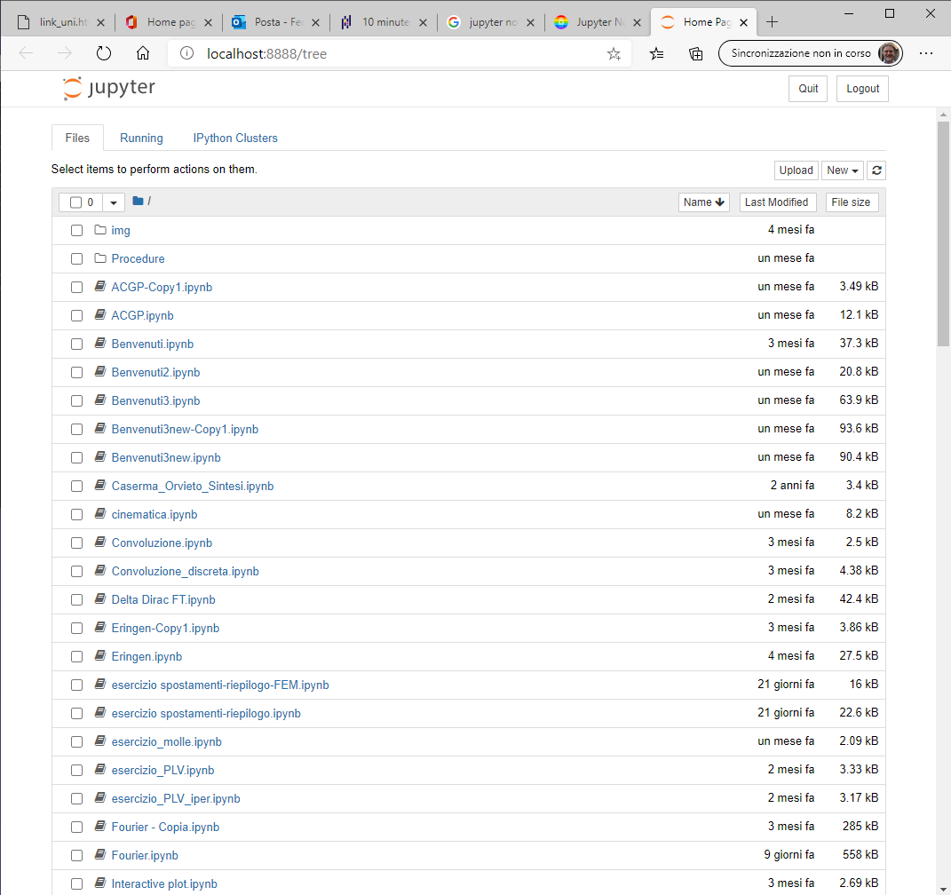
JUPYTER NOTEBOOKS
The notebook server
When launching Jupyter, a server providing the notebook functionality through the web browser is started.
Notes:
see also https://www.dataquest.io/blog/jupyter-notebook-tips-tricks-shortcuts/

Slide 16
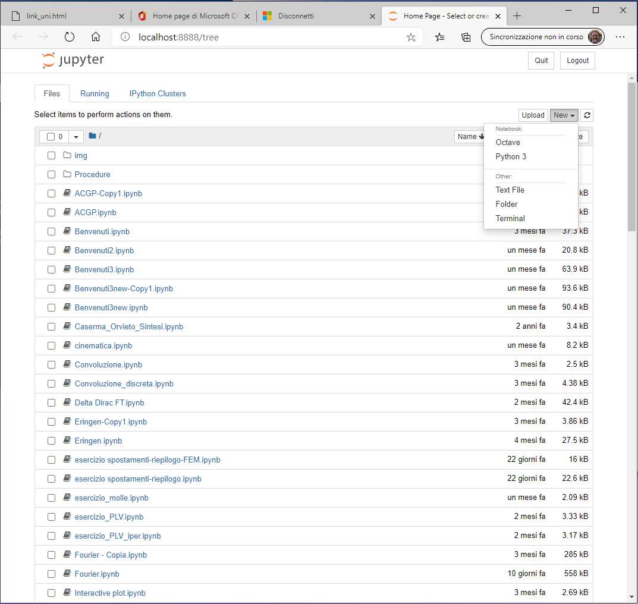
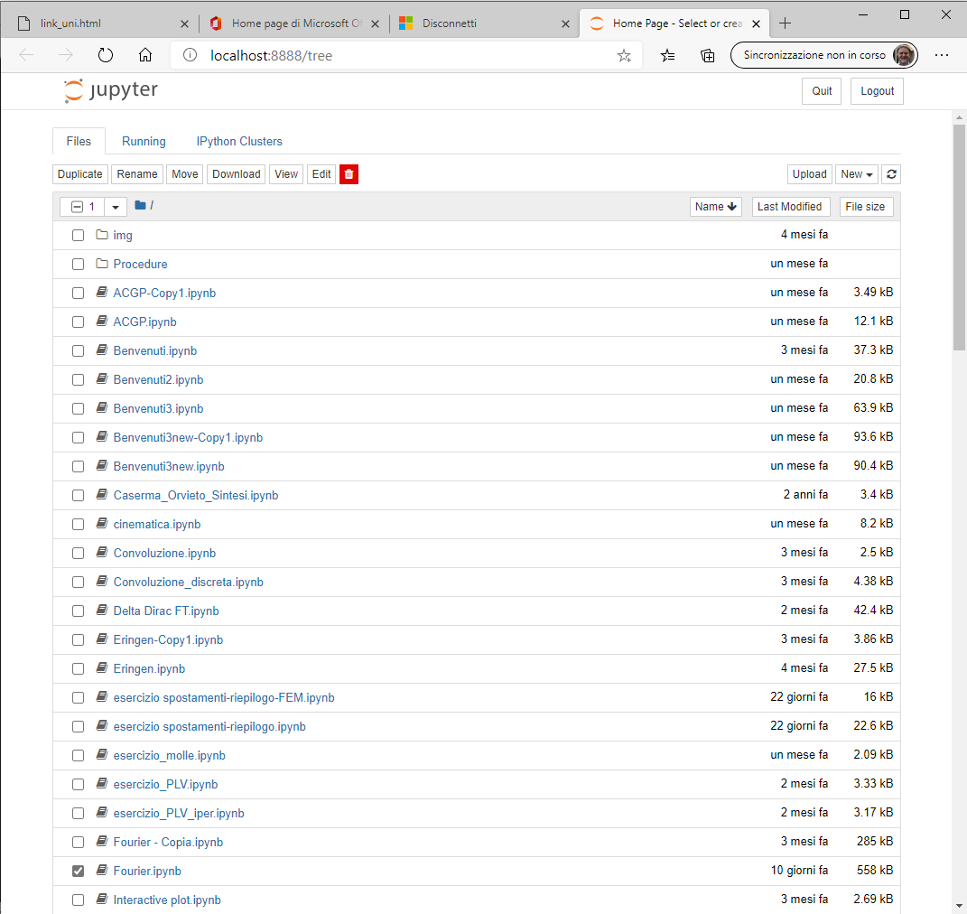
JUPYTER NOTEBOOKS
The notebook server
It is worth noting that several "kernels" may be used with Jupyter.
Moreover, the interface act as a "file explorer".

Slide 17
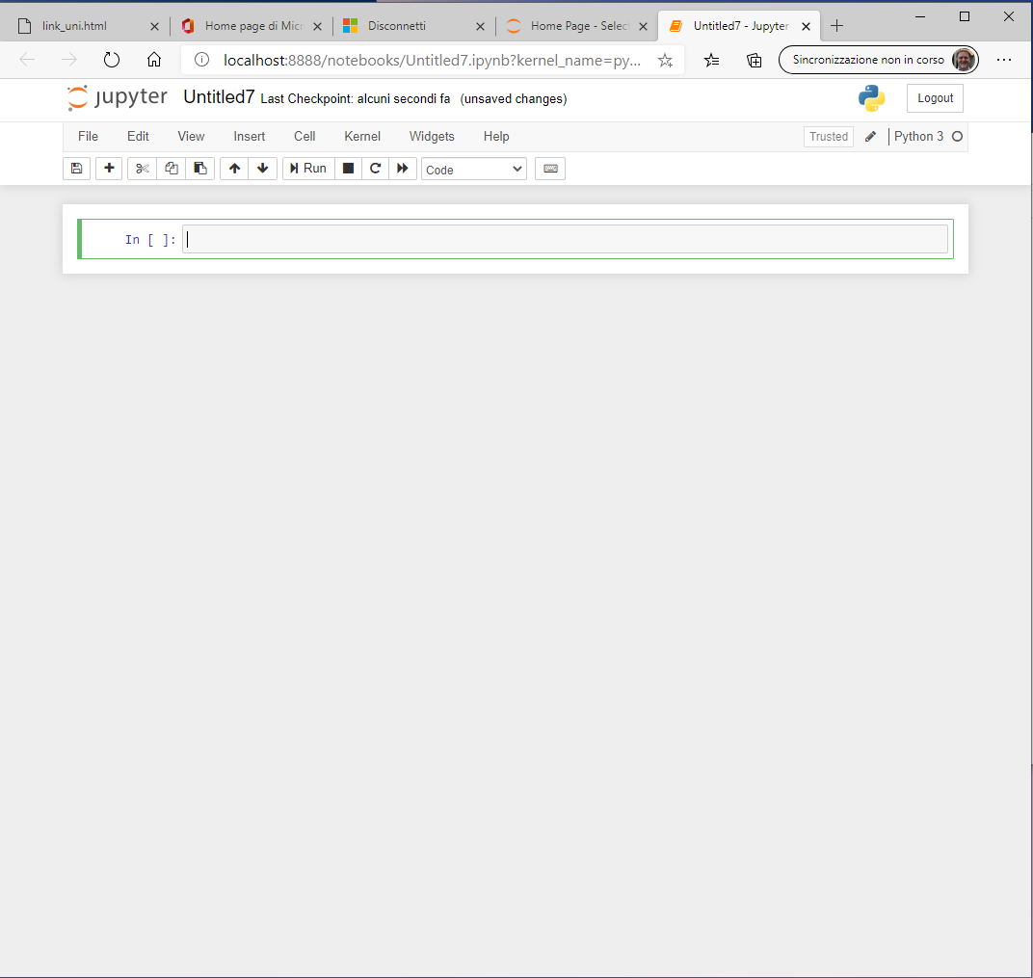
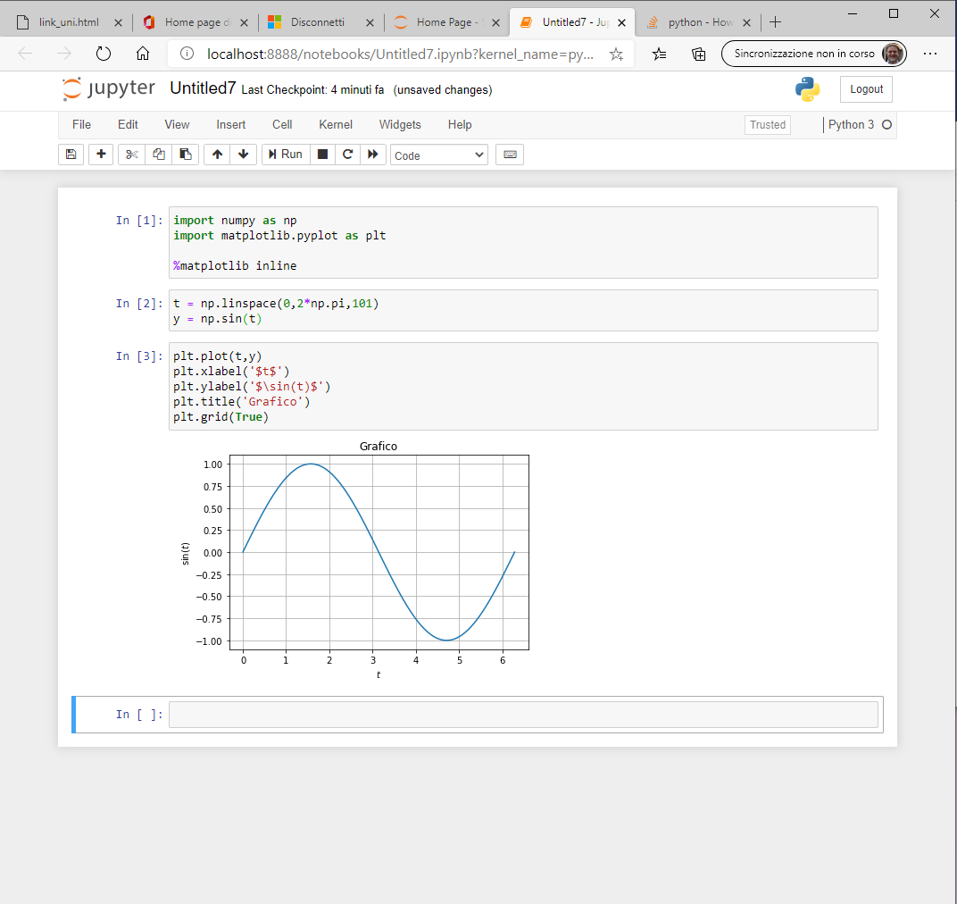
JUPYTER NOTEBOOKS
The notebook server
It is possible to insert Python code in the cell.
Note that "return" key allows to insert a new line of code, "shift"+"return" keys run the inserted code.

Slide 18
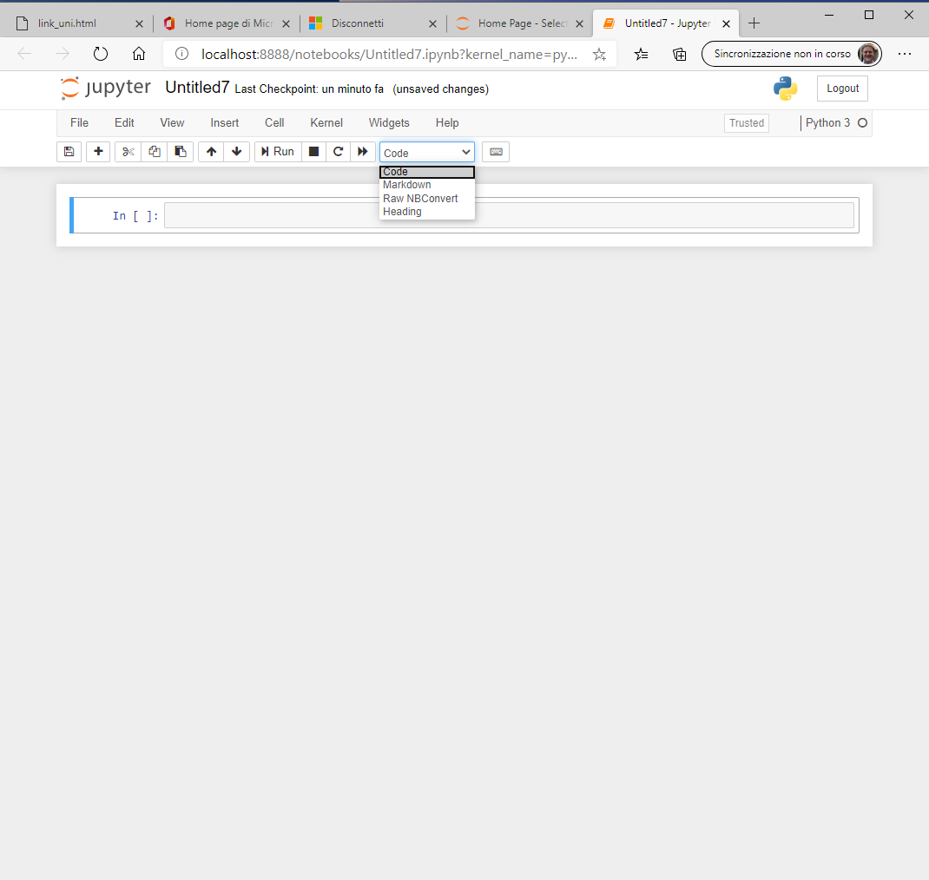
JUPYTER NOTEBOOKS
The notebook server
It is possible to insert Markdown code in the cell, which can also render math.

Slide 19
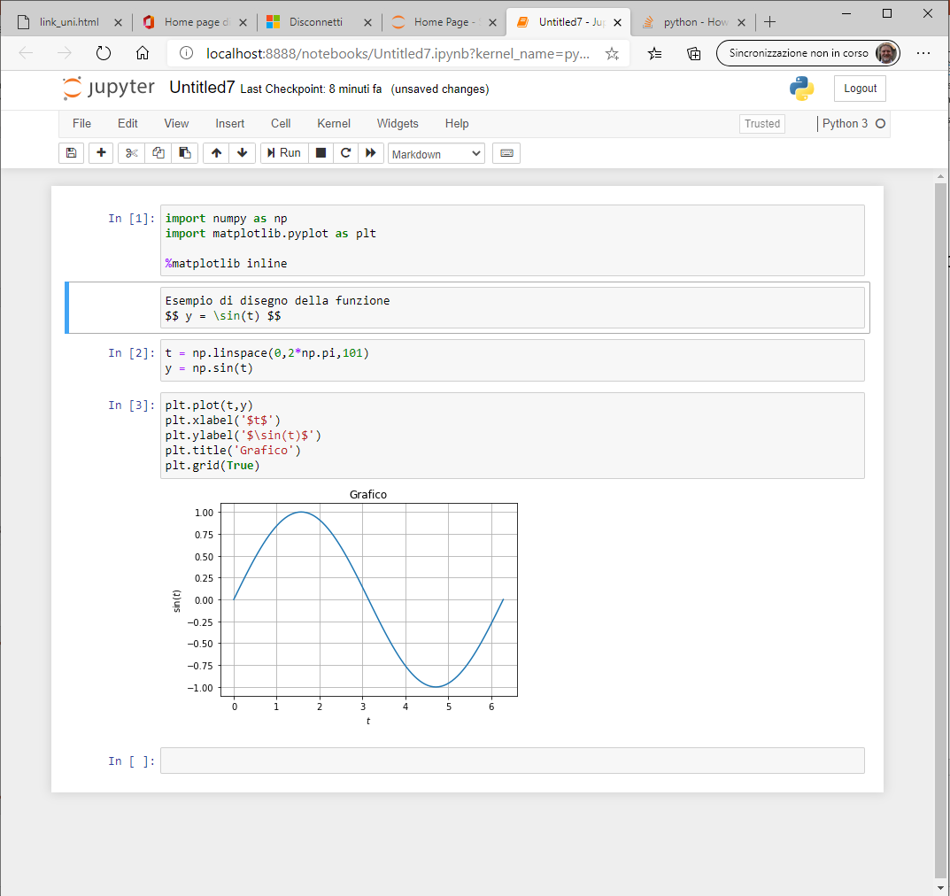
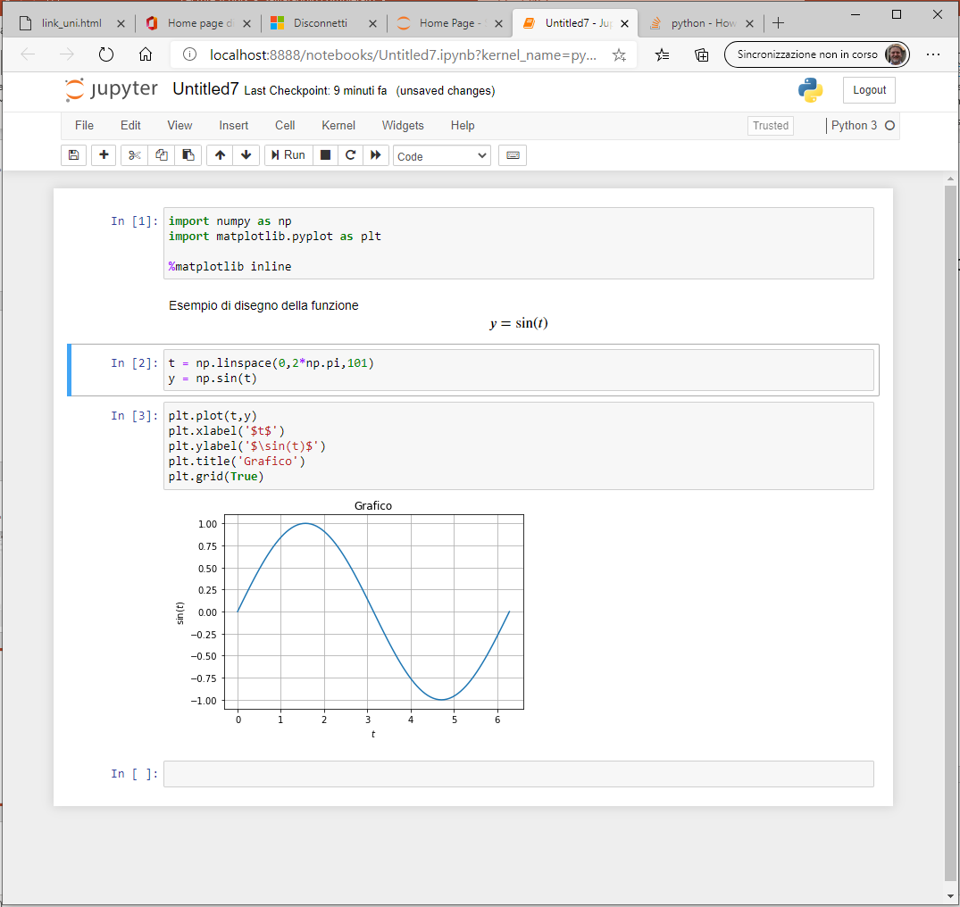
JUPYTER NOTEBOOKS
The notebook server
It is possible to insert Markdown code in the cell, which can also render math.
To see how to use markdown see here https://markdown-it.github.io/

Slide 20
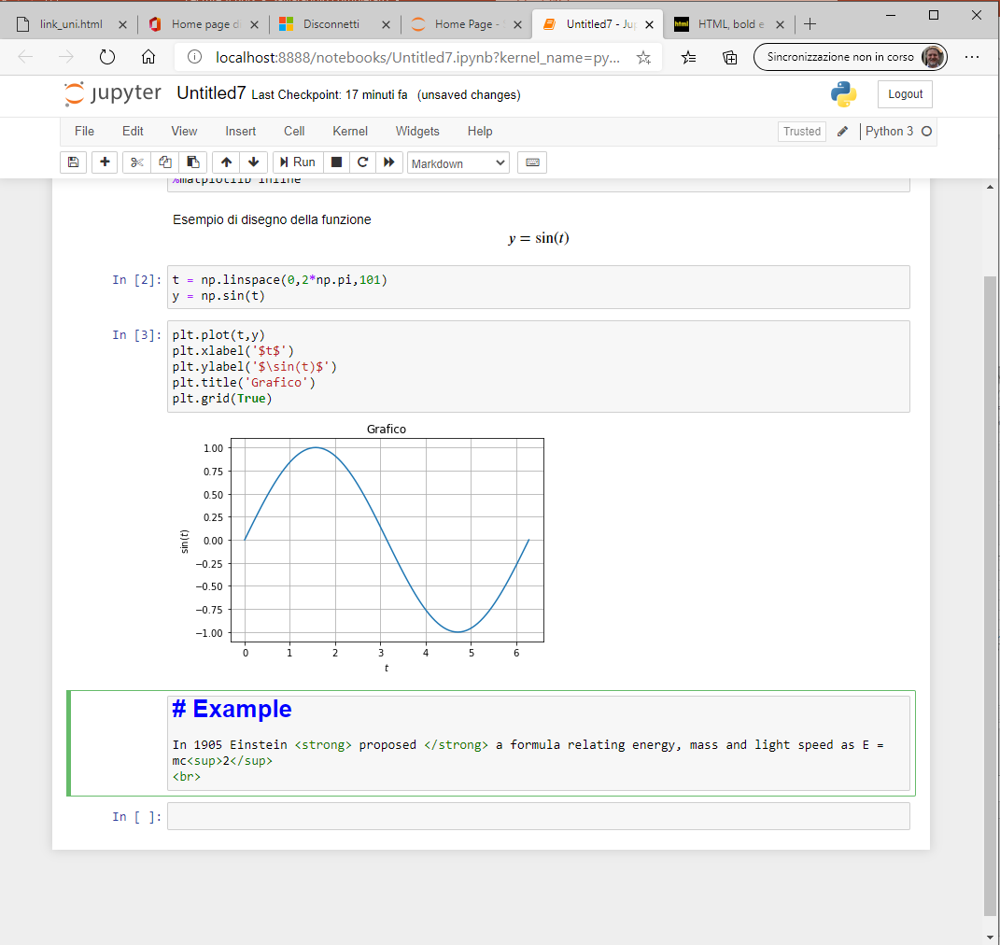
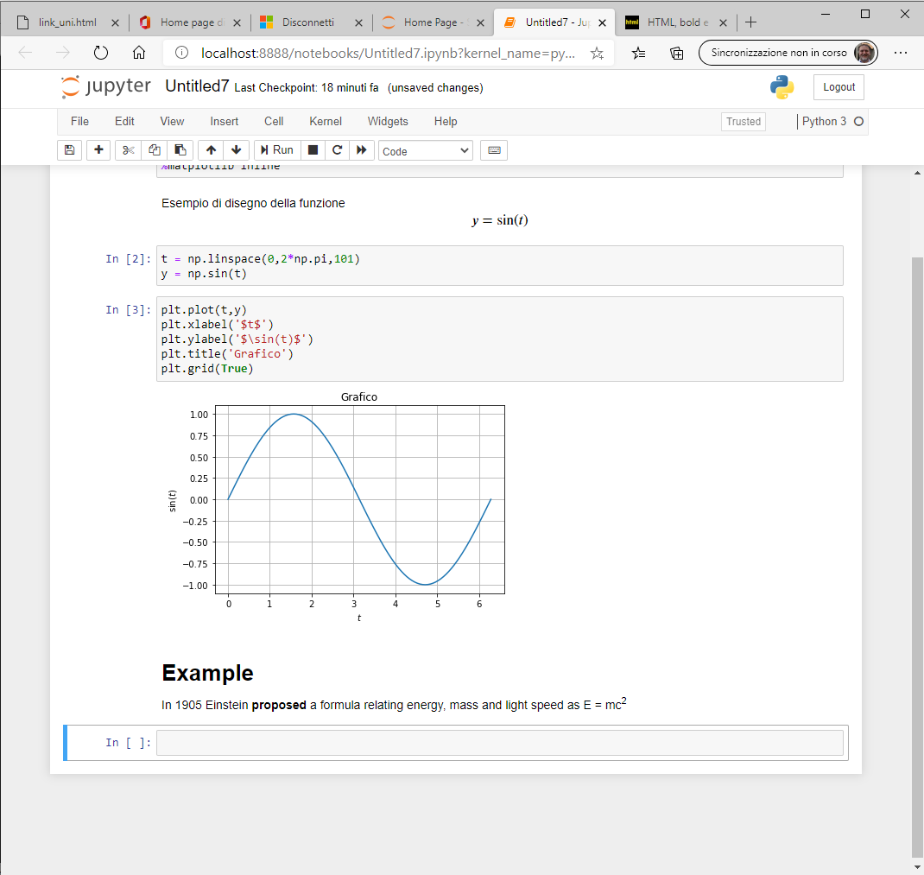
JUPYTER NOTEBOOKS
The notebook server
In Markdown cell html (markup) code can be executed.

Slide 21
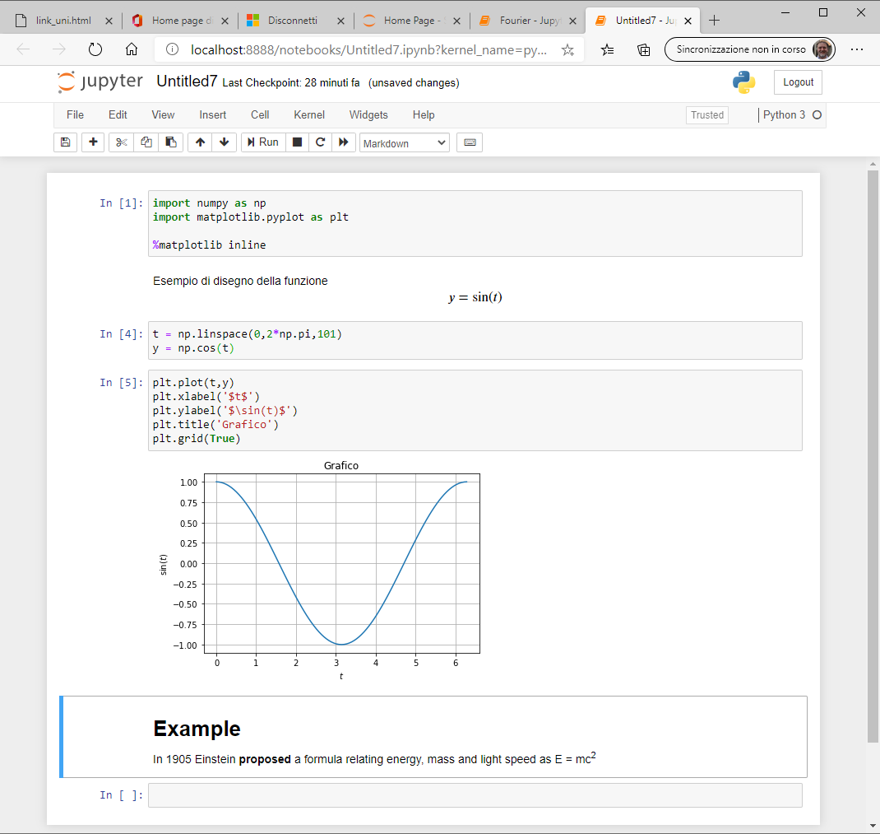
JUPYTER NOTEBOOKS
The notebook server
It is possible to edit the code previously inserted and see what happens!

Slide 22
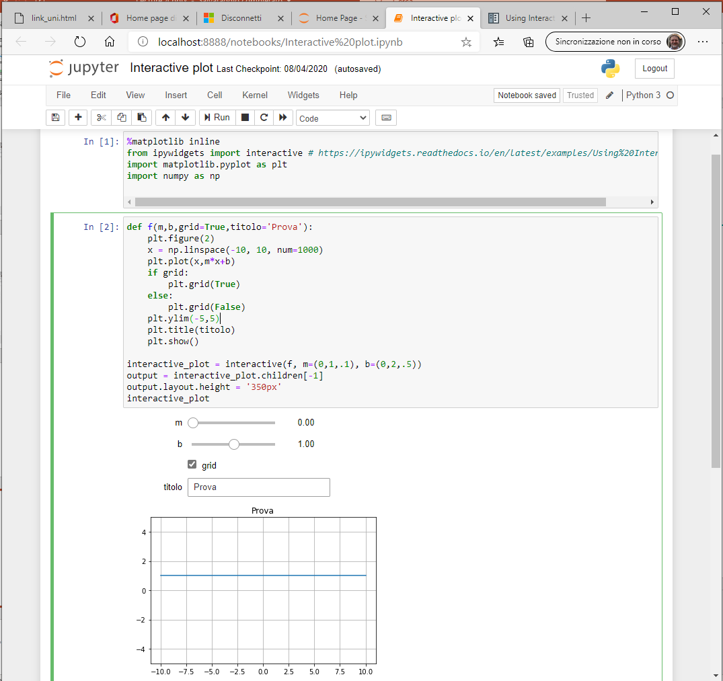
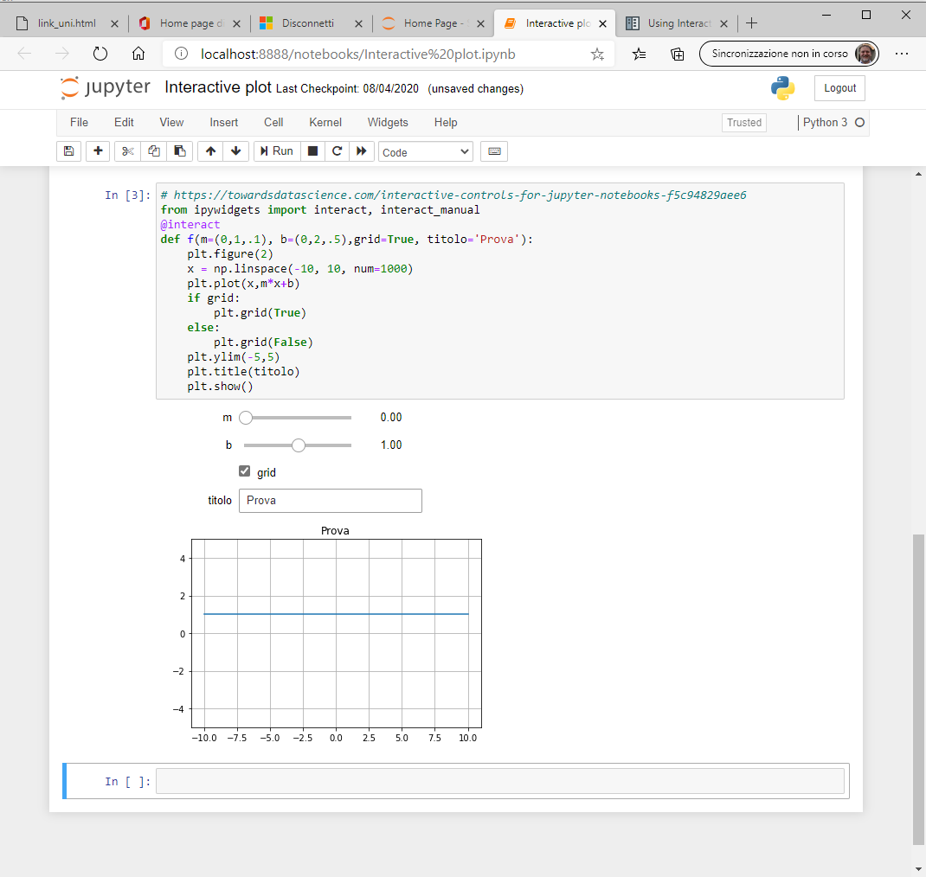
JUPYTER NOTEBOOKS
The notebook server
It is possible to define interactive controls.
See https://ipywidgets.readthedocs.io/en/latest/examples/Using%20Interact.htm
Notes:
«@interact is usefull if you are interested in exploring some data, and manipulating the "view" of some data.
Say you have precipitation graph per days for year 2000 to 2019, you don't want to plot 19 graph, you want to have 1 graph with a slider to select which year you want to see. Then you can do
@interact(year=(2000, 2019)) def plot_graph(year): ... That's it. You don't want to reuse the widget; you just interested in the interactivity and ability to change the "view". In this case we don't care about the user input. We really only care about changing some view parameters.
interactive() is there if you actually want to build something more tightly integrated; but for most data scientist inputing data via widgets is not that usefull. It is also a bad habit as this prevent the notebook from being reproducible with "restart and run all" as result depends from user input.» (from https://www.reddit.com/r/IPython/comments/cs4beg/whats_the_point_of_ipywidgets_interact_v/)

Slide 23
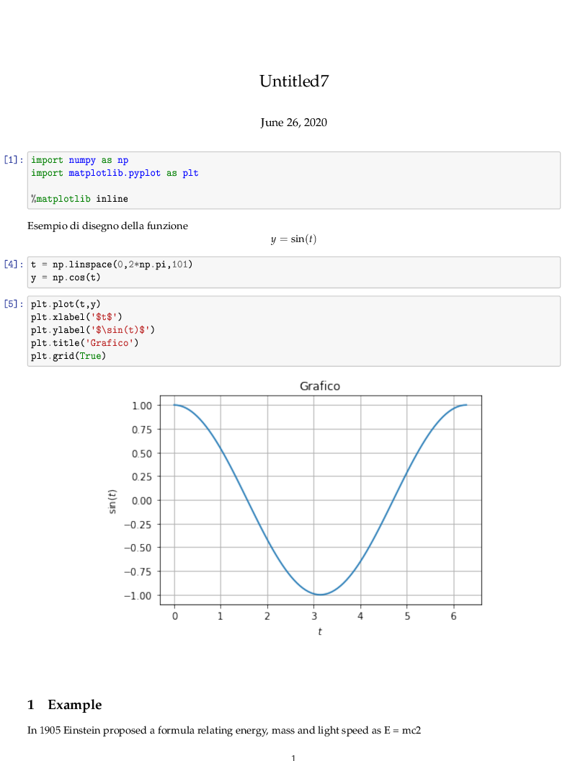
JUPYTER NOTEBOOKS
The notebook server
Note that several actions are possible on the notebook (for example, clear output and/or restart the cell).
Moreover, it is also possible to export the notebook, for example to LaTeX format

Slide 24
JUPYTER NOTEBOOKS
Magic commands
Jupyter Notebook inherits some magic commands from IPython
%timeit evaluate the time of execution of a command
%run execute code in a script
%store varname save the variable
%store –r varname load the variable
%who list names in global scope
%matplotlib inline plot the graphs in the notebook
Notes:
for more information on %store https://ipython.org/ipython-doc/stable/config/extensions/storemagic.html

Slide 25
Error handling
TRY/EXCEPT statement
In some situation the code can generate an error.
If the error was taken into account during programming, it can be handled without interrupting the flow of the code. Otherwise the program interrupts its running.
Non handled error
N = [100., 80., 0., 90., 75.]
Namm = 80.
for n in N:
print("Carico: ", n)
FS = Namm/n
print("Fattore di sicurezza: ", FS)

Slide 26
Error handling
Handled error
N = [100., 80., 0., 90., 75.]
Namm = 80.
for n in N:
print("Carico: ", n)
try:
FS = Namm/n
print("Fattore di sicurezza: ", FS)
except ZeroDivisionError:
print("Carico nullo!")

Slide 27
Error handling
Handled error
N = [100., 80., 0., 90., 75.]
Namm = 80.
for n in N:
print("Carico: ", n)
try:
FS = Namm/n
except ZeroDivisionError:
print("Carico nullo!")
else:
print("Fattore di sicurezza: ", FS)
Remark
This is the preferred syntax, since the block of code which can generate the error is separated from the remaining part of the code.

