Slide 1
UNIVERSITÀ DEGLI STUDI DI PERUGIA
International Doctoral Program in
Civil and Environmental Engineering
PYTHON FOR NUMERICAL COMPUTING AND DEVELOPMENT OF SCIENTIFIC APPLICATION
Prof. Federico Cluni
A. Y. 2021/22
Lesson #4 – May 12, 2022

Slide 2
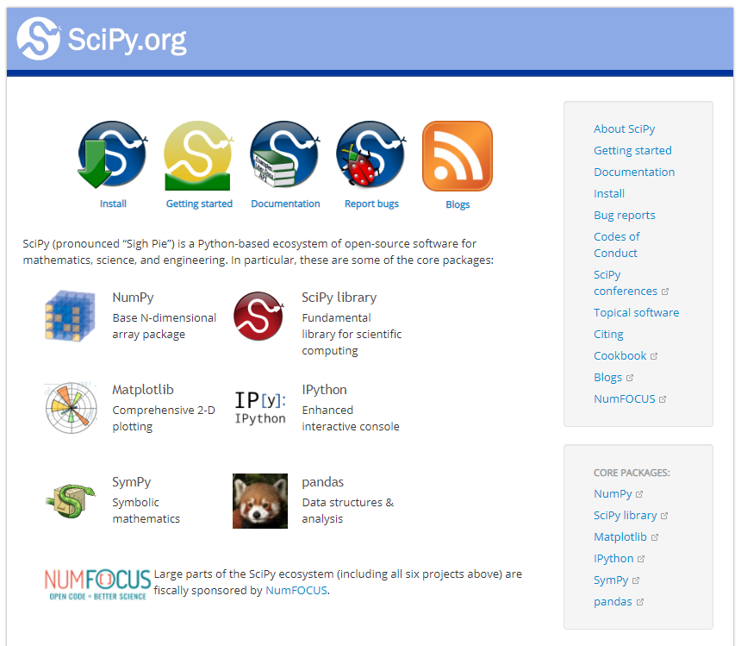
THE SCIPY “ECOSYSTEM”
Notes:
scipy.org

Slide 3
NUMPY
ARRAY < type ‘ndarray’ >
It is a multi-dimensional (may have more than one index) with homogeneous elements and fixed dimension.
There are constructors for some typical cases:
import numpy as np
a = np.zeros(4)
a = np.ones((2,3,4))
a = np.arange(-5.,5.,1.)
a = np.linspace(-5.,5.,100)
Array can also be generated through list and tuples:
l = [1., 2., 3. ]
a = np.array(l)
N.B this is the “standard” way of importing numpy
Remark
As usual with object, b=a create an alias and not a copy. To obtain a copy:
b = a.copy()

Slide 4
NUMPY
ARRAY < type ‘ndarray’ >
It is possible to redistribute the elements among dimension.
import numpy.random as rd
a = rd.randint(-10,10,(2,3,4))
a.shape = (2,12)
or
a.reshape (2,12)
Usual slicing operation to extract portions of the array:
a[indexes dim. 0, indexes dim. 1, :]
To take all elements of one dimension, use «:»
Note that slicing produce views of the array, i.e. a[:,:] does not produce a new array!
To access the element at place i
a.item(i)
The 1-dimensional representation (as a view) is given by
a.ravel()
N.B numpy.random module is more powerful than random

Slide 5
NUMPY
ARRAY < type ‘ndarray’ >
To iterate on the dimension
for i in range(a.shape[0]):
for j in range(a.shape[1]):
...
The usual operations
+, -, /, *, **
are possible, in such a case the operation is applied to all elements in the array
b = 2*a
Some useful methods
a.max() a.argmax()
a.min() a.argmin()
a.mean() a.std()

Slide 6
NUMPY
MATRIX < type ‘matrix’ >
To define matrices:
m = matrix( list/array )
or:
m = mat( list/array )
Usual matrix operations are defined (in particular, * is matrix multiplication).
To perform matrix multiplication using arrays, use @.
In old Python versions, to matrix multiply two array a and b: c=dot(a,b).

Slide 7
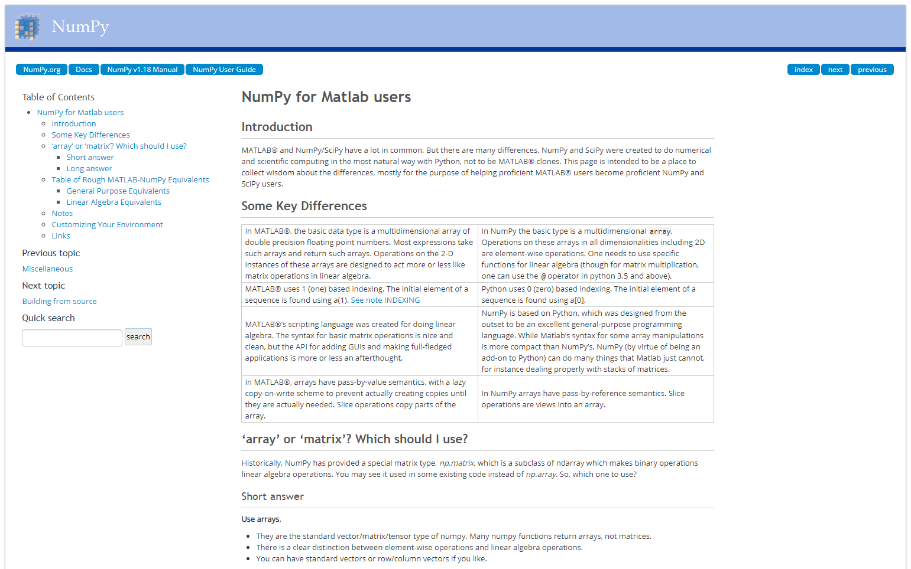
NUMPY
The “Rosetta stone” for Matlab users
https://numpy.org/doc/stable/user/numpy-for-matlab-users.html

Slide 8
NUMPY - VECTORIALIZATION
An array can be used as the argument of a function. Anyway, if there is a if condition, the condition can not be evaluated:
def funz(x):
if x < 0:
return -1
else:
return 2*x
In such cases, the command where can be used:
def funz(x):
return np.where( x < 0, -1, 2*x)
It is worth noting that this last function can be called with a scalar as an argument.
Otherwise
funzv = np.vectorize(funz)

Slide 9
NUMPY - USEFUL SUBMODULES/FUNCTIONS
There are several submodules in Numpy, for example random, fft, linalg
To import a submodule
import numpy.random as rd
import numpy.linalg as la
A = rd.randint(-10,10,(3,3))
b = rd.randint(-10,10,3)
if not np.isclose(la.det(A),0,atol=1e-12):
c = la.solve(A,b)
c1 = np.dot(la.inv(A),b)
w, v = la.eig( A ) # solution of A@v = wv

Slide 10
NUMPY - USEFUL SUBMODULES/FUNCTIONS
To write/read to a file (in text format)
import numpy as np
x = np.random.uniform(size=(10,3))
np.savetxt('dati.txt',x,'%7.4f',';')
y = np.loadtxt('dati.txt',delimiter=';')

Slide 11
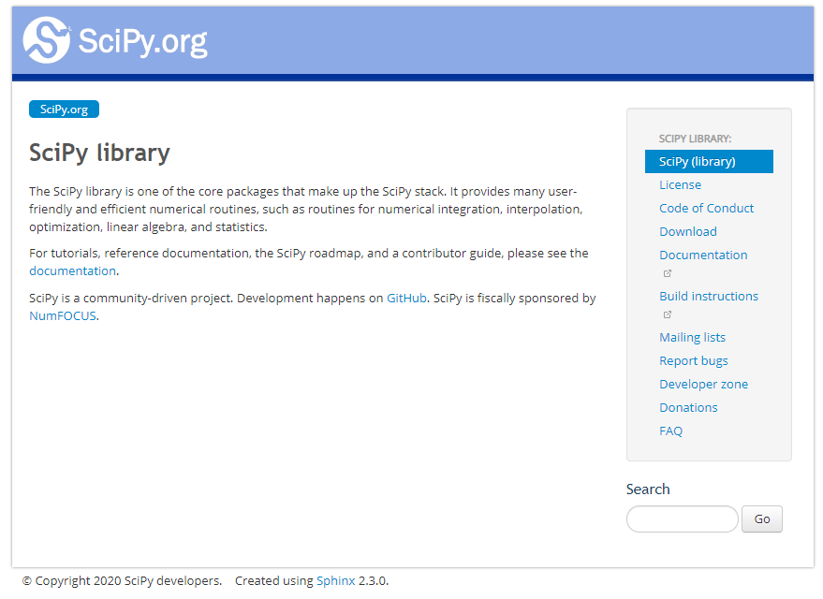
SCIPY

Slide 12
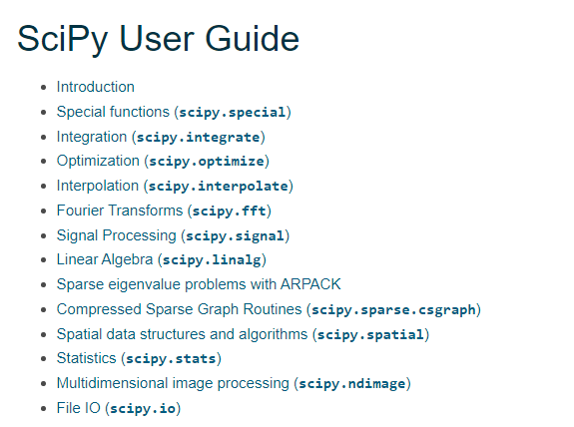
SCIPY
Modules of SciPy (https://docs.scipy.org/doc/scipy/tutorial/index.html)
Reference here: https://docs.scipy.org/doc/scipy/reference/

Slide 13
SCIPY - LINALG
A (very) simple example: solve the following system of linear equations
import numpy as np
import scipy
import scipy.linalg as la
A = np.array([[2.,-3.],[1., 4.]])
b = np.array([1., -2.])
xy = la.solve(A,b)
print('x = %f\ny = %f'%(x[0], x[1]))

Slide 14
SCIPY - LINALG
Another (very) simple example: solve the eigenproblem associated to the following matrix
import numpy as np
import scipy
import scipy.linalg as la
A = np.array([[100.,-30.,0.],[-30.,-200.,0.],[0.,0.,50.]])
L, V = la.eig(A)
The eigenvalues are the entries of L, the corresponding eigenvectors are the columns of V. To verify for second eigenvalue/eigenvector:
A@V[:,1]-L[1]*V[:,1]
* it means: given matrix A, find scalar λ and vector v such that

